Slide 1
Machine Learning 기초
확률이론 (Probability Theory)
Yahoo! Research
강창성
cskang@yahoo.com

Slide 2
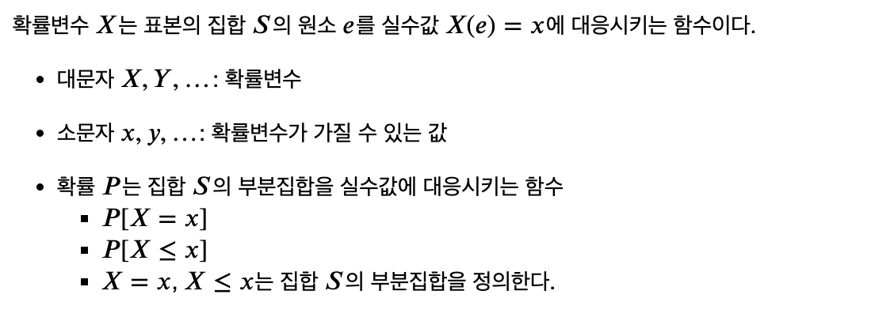
확률변수 (Random Variable)
확률이론 (Probability Theory)

Slide 3
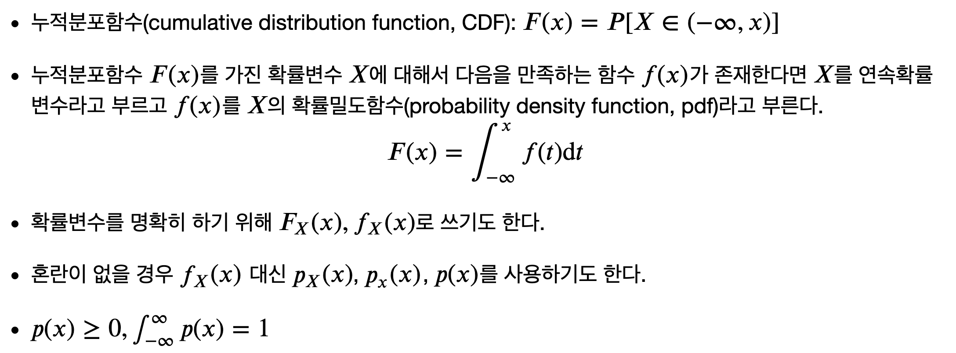
연속확률변수 (Continuous Random Variables)
확률이론 (Probability Theory)
Notes:
Cumulative distribution function: 누적분포함수

Slide 4
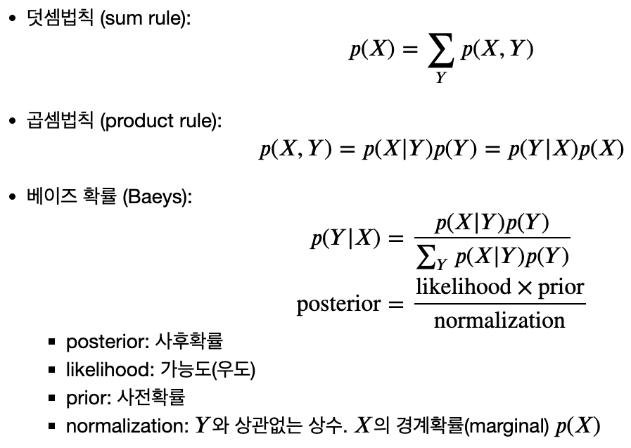
확률변수의 성질 (The Rules of Probability)
확률이론 (Probability Theory)

Slide 5
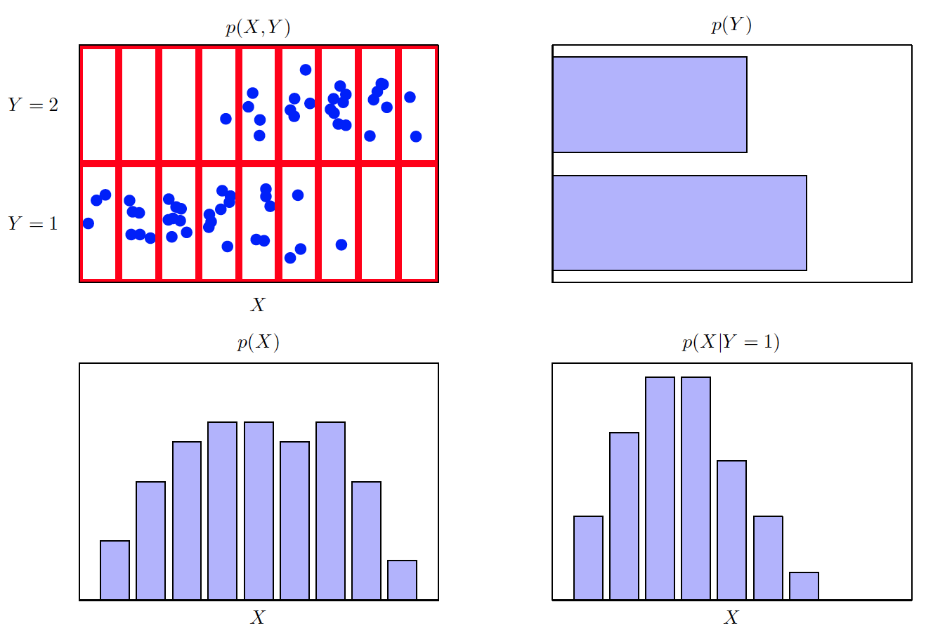
예제: 주변확률(Marginal)분포, 조건부(Conditional)확률분포
확률이론 (Probability Theory)

Slide 6
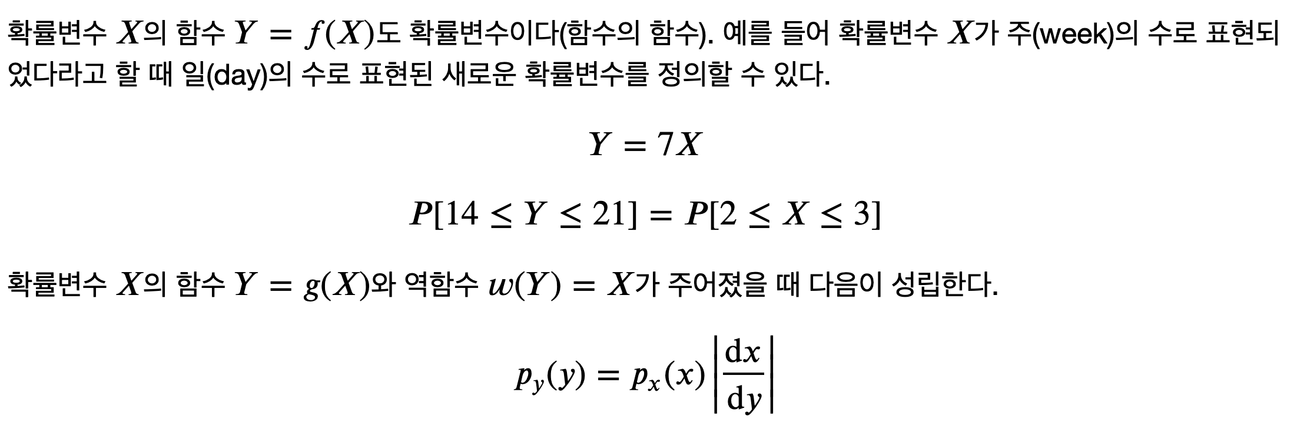
확률변수의 함수(Functions of Random Variables)
확률이론 (Probability Theory)

Slide 7
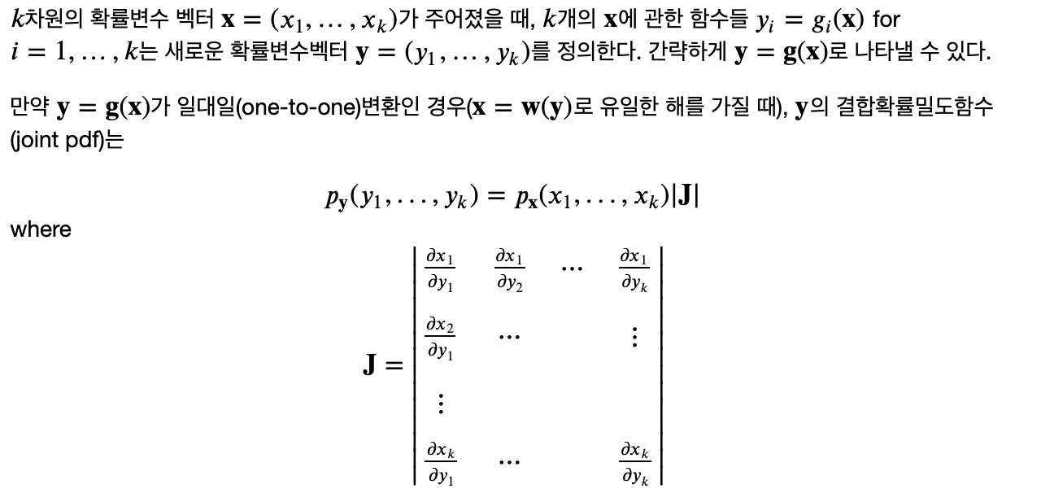
확률변수의 함수(Functions of Random Variables)
확률이론 (Probability Theory)
Notes:
일반적인 경우

Slide 8
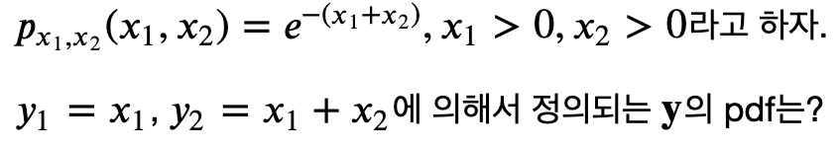
예제
확률이론 (Probability Theory)

Slide 9
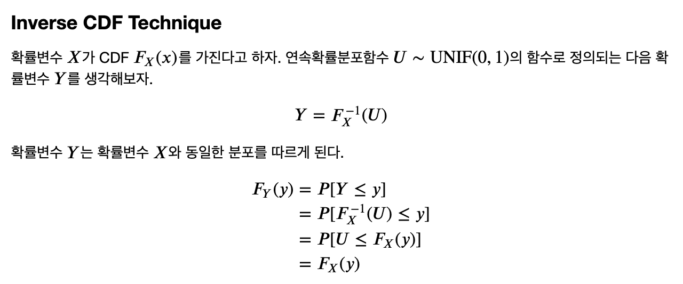
확률변수의 함수(Functions of Random Variables)
확률이론 (Probability Theory)

Slide 10
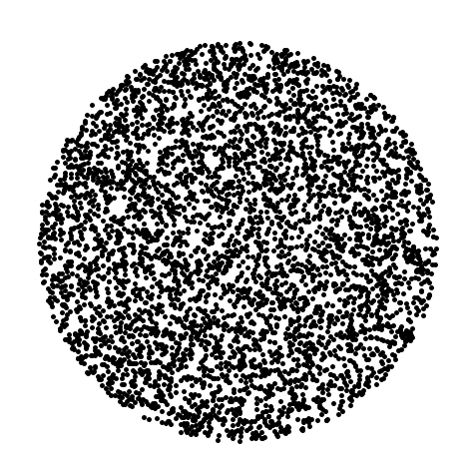
확률변수의 함수(Functions of Random Variables)
확률이론 (Probability Theory)
반경이 r인 원 안에 랜덤하게 점들을 찍는 프로그램?

Slide 11
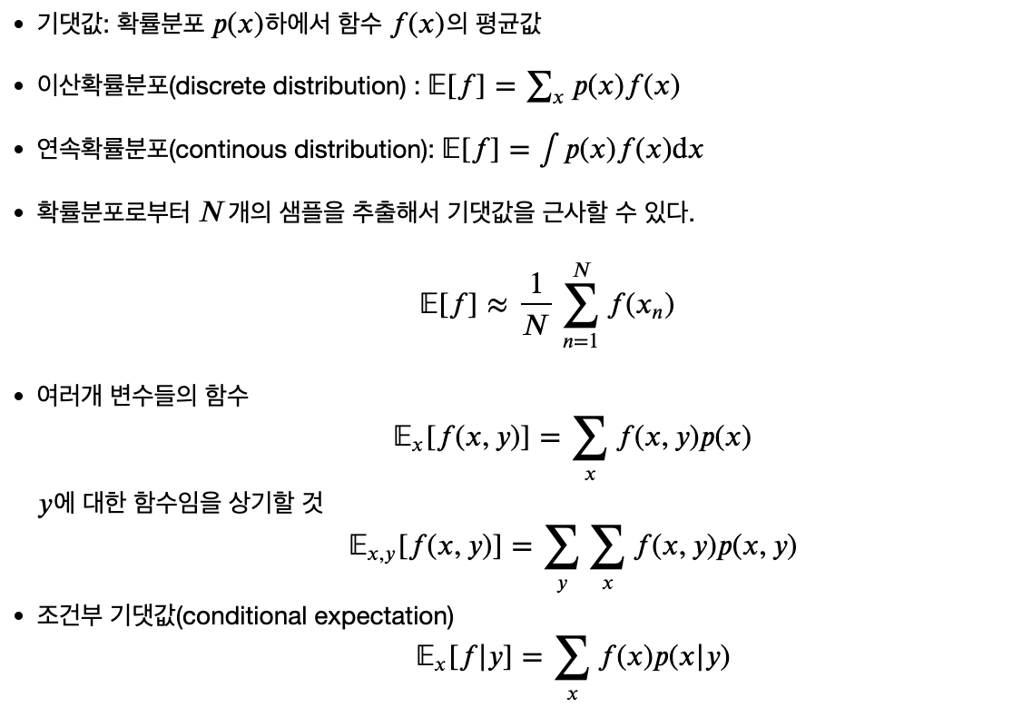
기댓값 (Expectations)
확률이론 (Probability Theory)

Slide 12
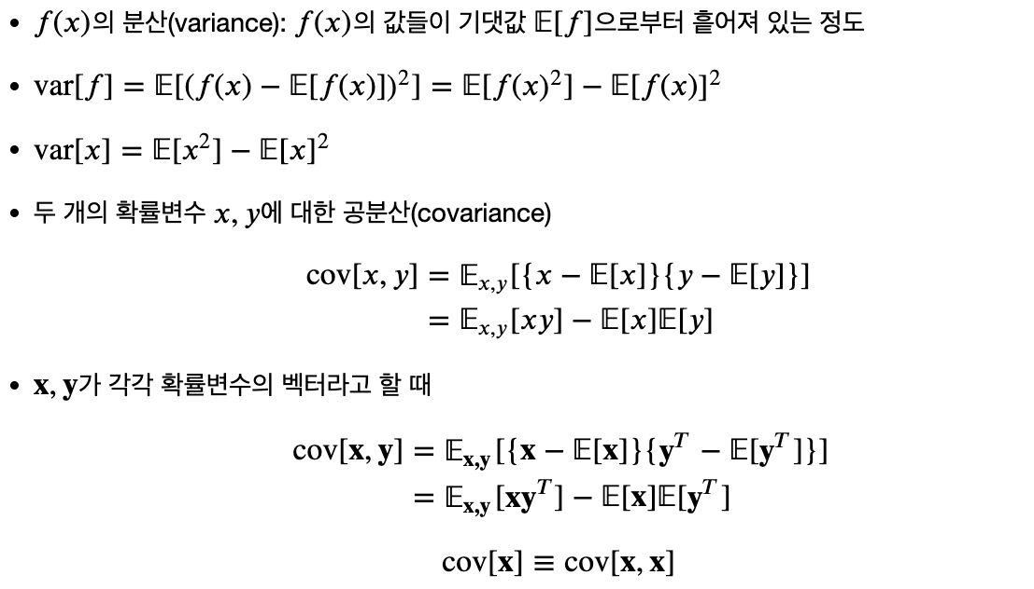
분산(variance), 공분산 (covariance)
확률이론 (Probability Theory)

Slide 13

빈도주의 대 베이지안(Frequentist versus Bayesian)
확률이론 (Probability Theory)

Slide 14
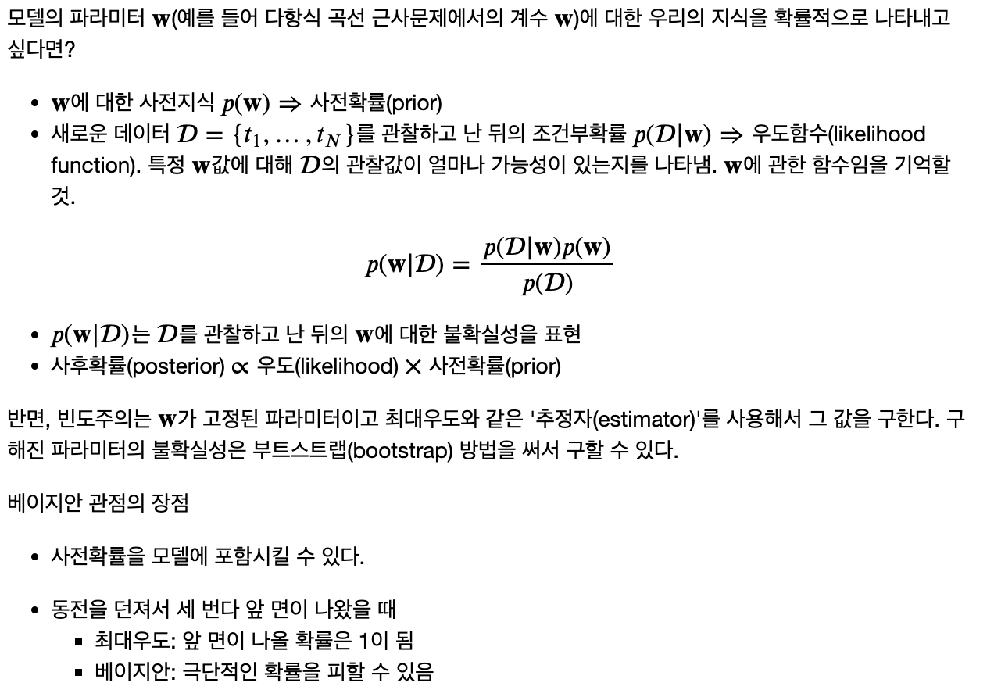
빈도주의 대 베이지안(Frequentist versus Bayesian)
확률이론 (Probability Theory)

Slide 15
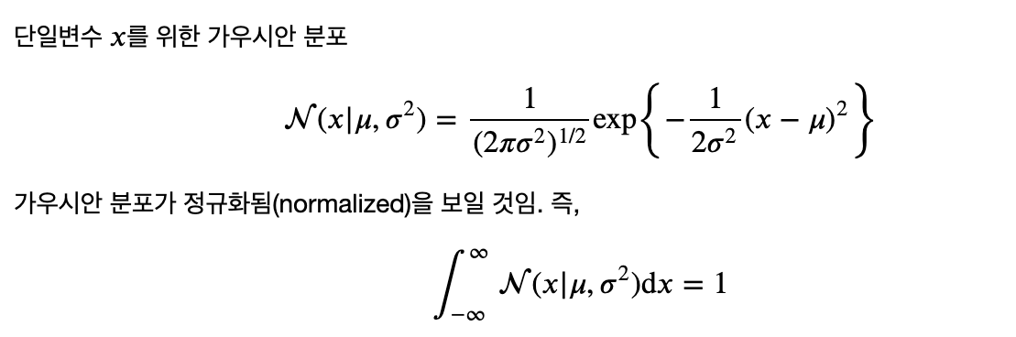
정규분포 (Gaussian Distribution)
확률이론 (Probability Theory)

Slide 16
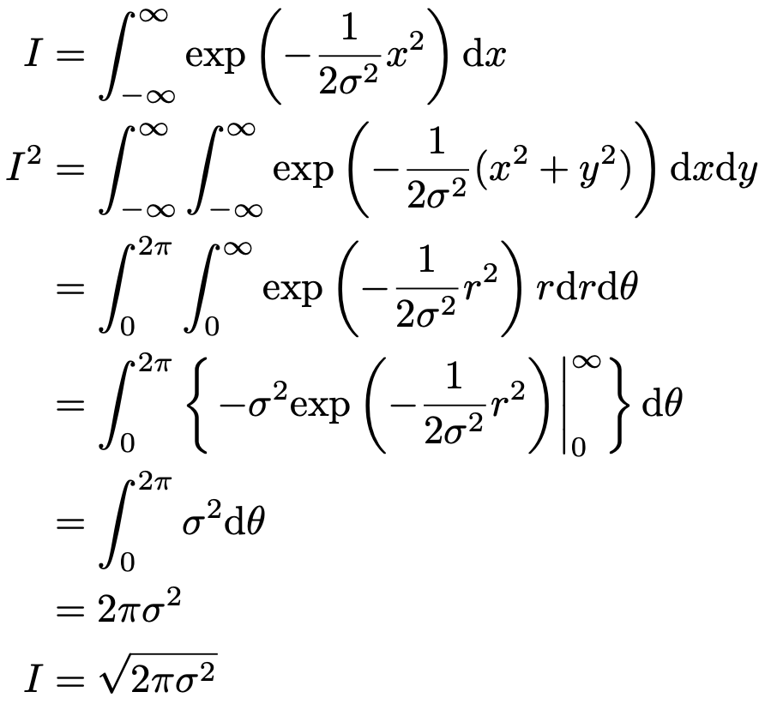
정규분포 (Gaussian Distribution): 정규화(Normalization) - Optional
확률이론 (Probability Theory)

Slide 17
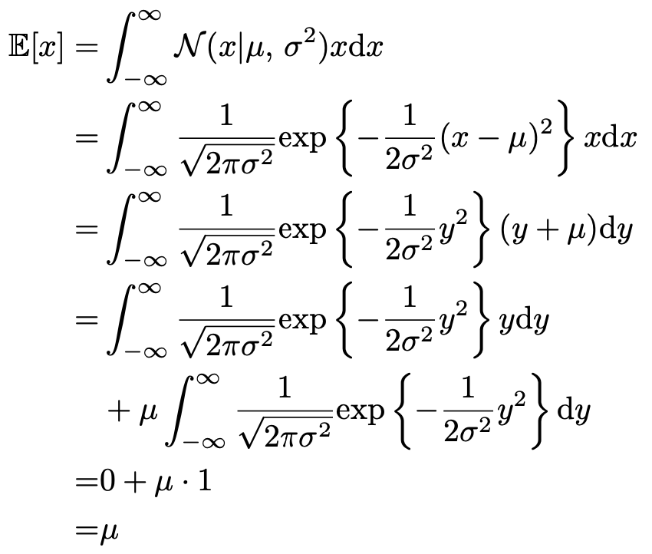
정규분포 (Gaussian Distribution): 기댓값 (Expectation) - Optional
확률이론 (Probability Theory)

Slide 18

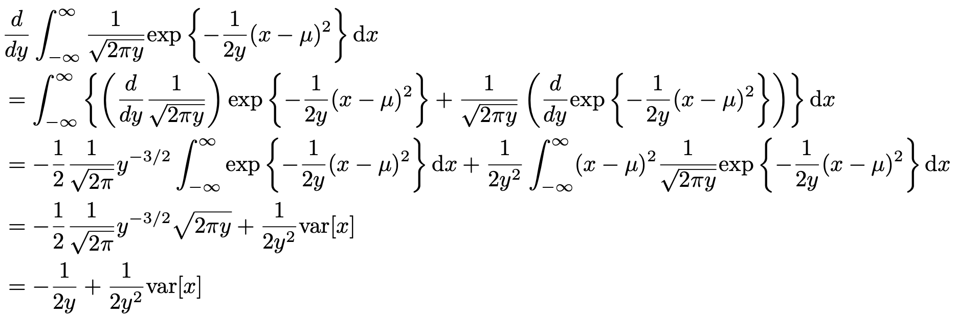

정규분포 (Gaussian Distribution): 분산 (Variance) - Optional
확률이론 (Probability Theory)

Slide 19
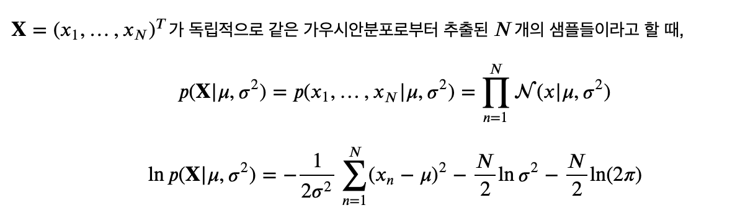
정규분포 (Gaussian Distribution): 최대우도해 (Maximum Likelihood solution)
확률이론 (Probability Theory)

Slide 20
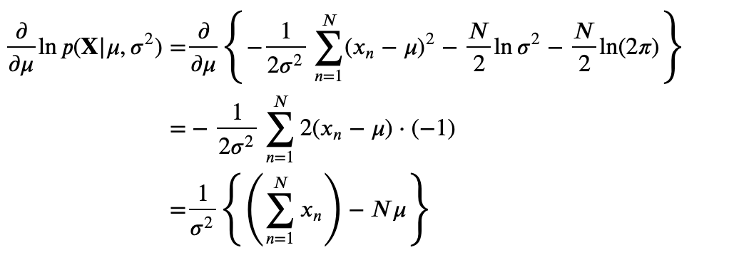
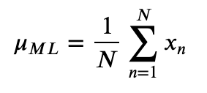
정규분포 (Gaussian Distribution): 최대우도해 (Maximum Likelihood solution)
확률이론 (Probability Theory)

Slide 21

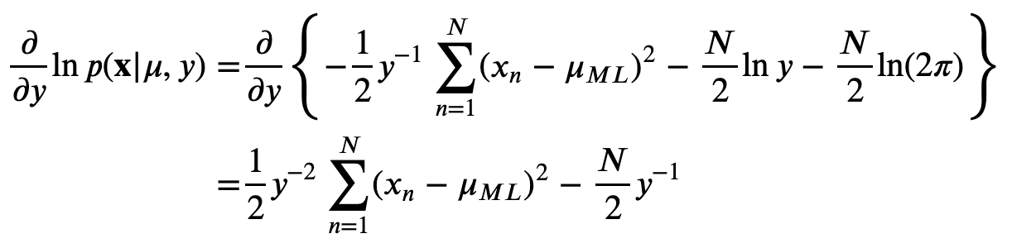
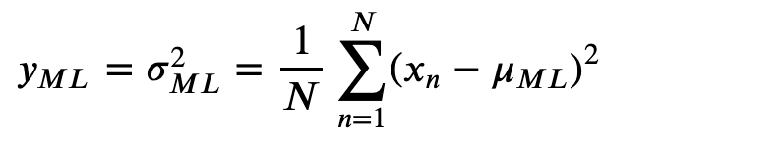
정규분포 (Gaussian Distribution): 최대우도해 (Maximum Likelihood solution)
확률이론 (Probability Theory)

Slide 22
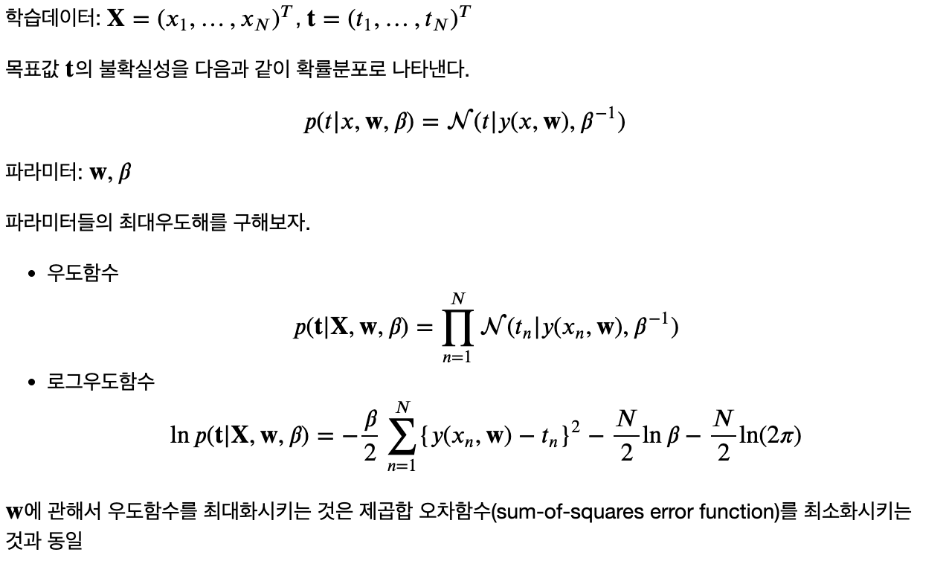
곡선근사(Curve Fitting): 확률적 관점
확률이론 (Probability Theory)

Slide 23
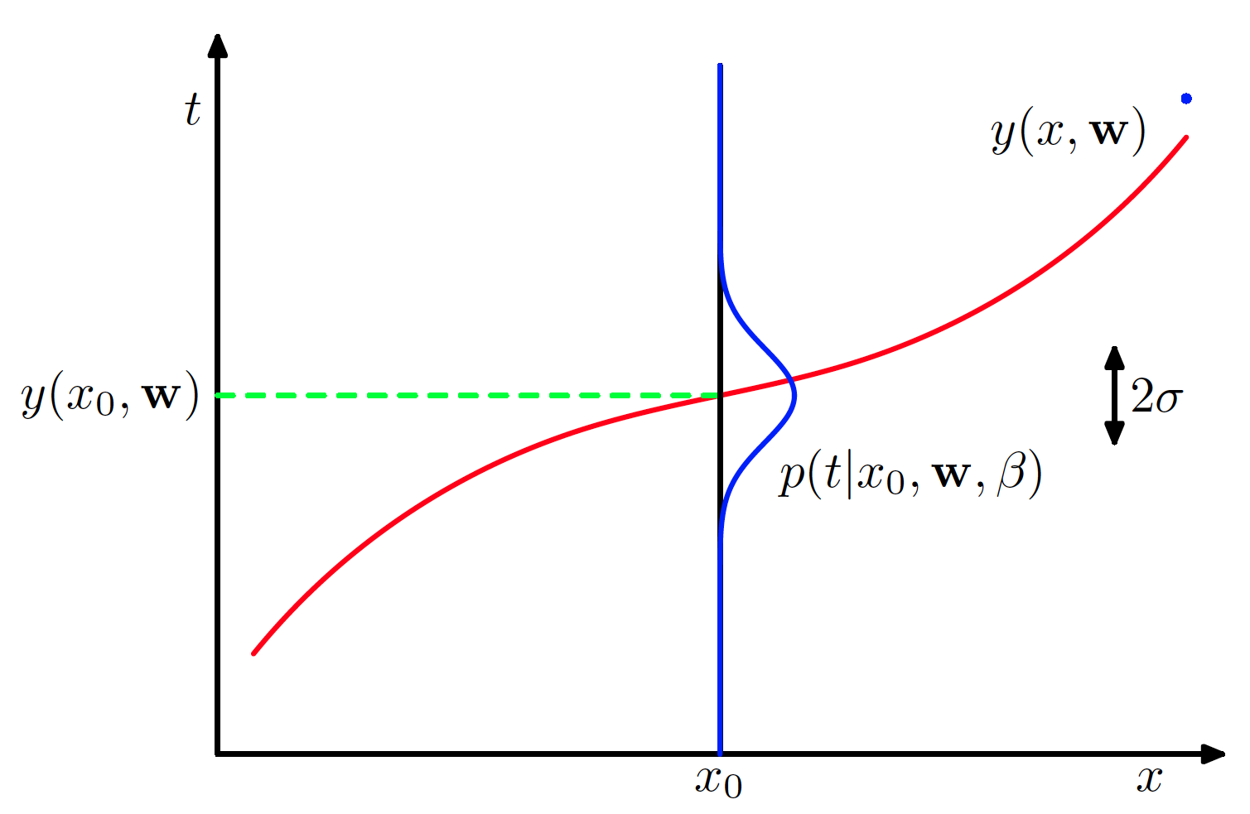
곡선근사(Curve Fitting): 확률적 관점
확률이론 (Probability Theory)

Slide 24
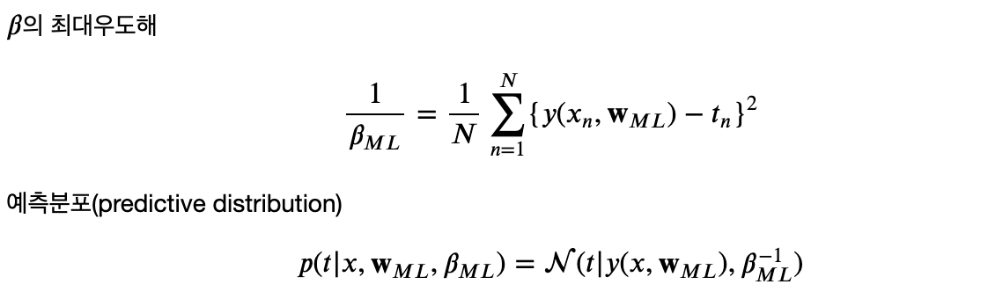
곡선근사(Curve Fitting): 확률적 관점
확률이론 (Probability Theory)

Slide 25
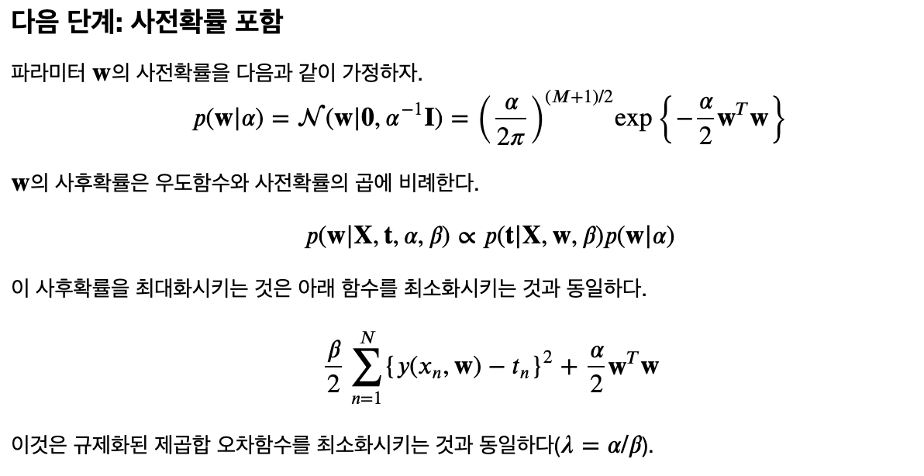
곡선근사(Curve Fitting): 확률적 관점
확률이론 (Probability Theory)

Slide 26
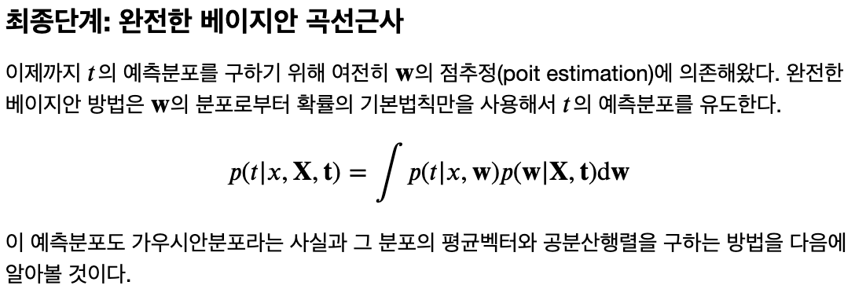
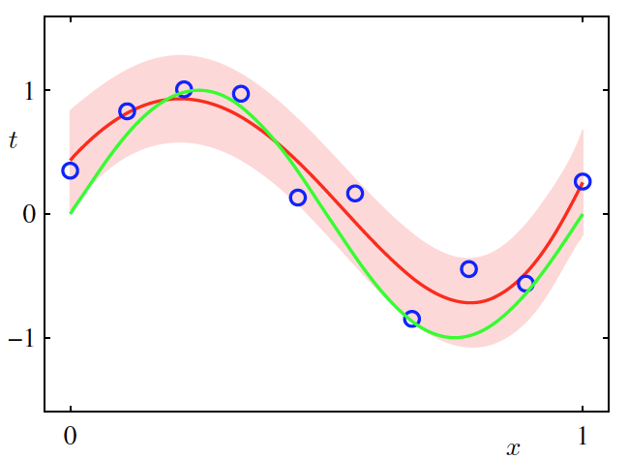
베이지안 곡선 근사(Bayesian Curve Fitting)
확률이론 (Probability Theory)

Slide 27
감사합니다!
Yahoo! Research
강창성
cskang@yahoo.com

